Slide 1
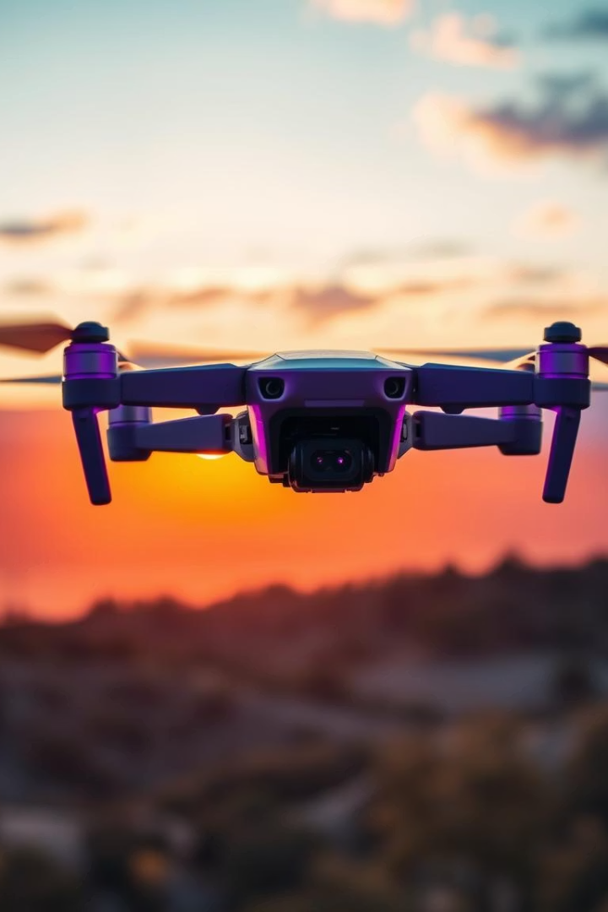
Advanced Drone Building using Orange Pi 5
Team Members: Sanjay Kathula, Sai Kumar Gadde
Integrating AI and sensor tech on embedded platforms for advanced drone features.

Slide 2
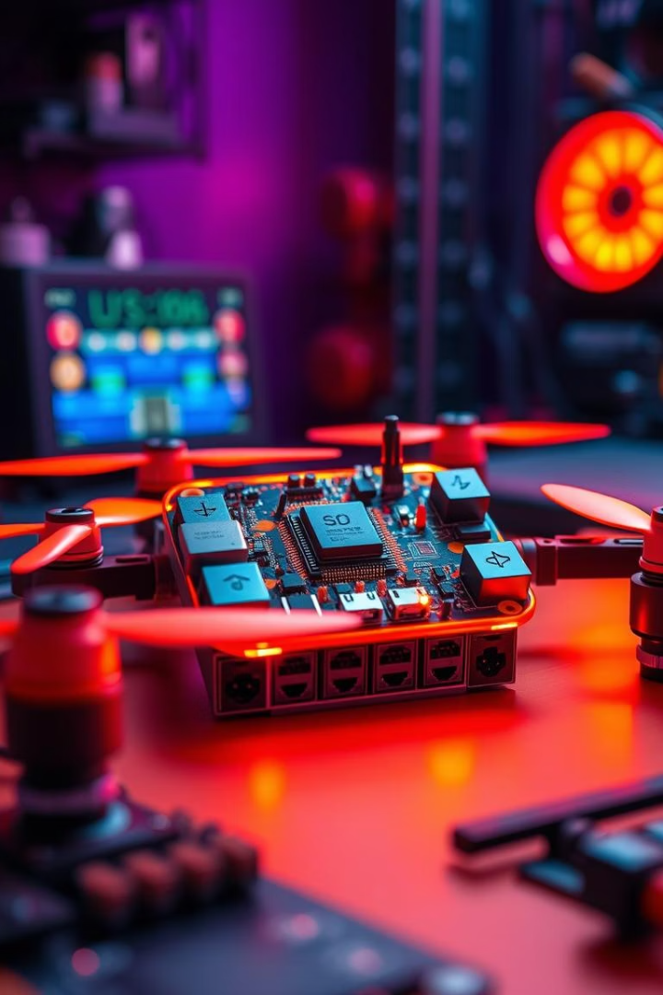
Project Goals
Follow-Me Feature
Real-time target tracking using AI vision models
Obstacle Avoidance
Integrate LiDAR-based proximity sensing
Gesture Control
Hand gesture recognition for drone commands
Embedded AI Deployment
Efficient model inference on Orange Pi 5

Slide 3
Project Outcomes
Hardware Setup
Feature Implementation
Communication
Experience Gained
Orange Pi 5, Pixhawk 6X, TFMini Plus LiDAR, and reCamera
MAVLink protocol for real-time data exchange
Embedded AI and sensor integration knowledge
Follow-Me
Obstacle Avoidance
Gesture Control

Slide 4
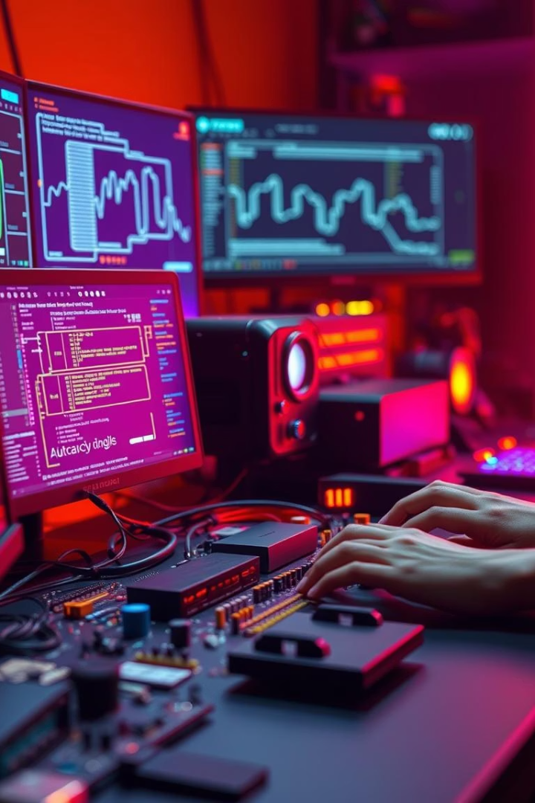
Project Accomplishments
Software
Devices Interfaced
Python OpenCV for video processing
reCamera USB/MIPI CSI
pyserial based LiDAR data reading
TFMini Plus LiDAR UART
pymavlink for MAVLink commands
Pixhawk 6X UART MAVLink
TensorFlow Lite gesture detection
ReSpeaker Mic Array (concept)
Voice control module design
Platform
Orange Pi 5 on Ubuntu, AI with TensorFlow Lite

Slide 5
Our Contributions
Sai Kumar Gadde
Sanjay Kathula
AI integration and sensor processing
Pixhawk integration and MAVLink control
Camera and LiDAR data scripts
Hardware setup and power management
Gesture recognition model development
System integration and real-world tests

Slide 6
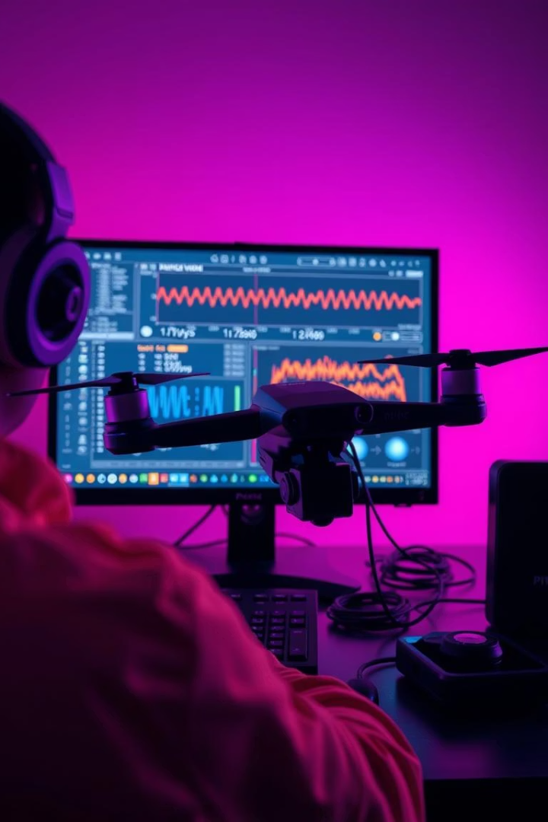
Software and Testing
1
Software Modules
Camera capture and OpenCV processing
LiDAR distance filtering
MAVLink commands for flight control
Gesture classifier and logic
2
Testing Approach
Camera resolution and lighting tests
LiDAR distance and material tests
MAVLink command debugging
Gesture accuracy validation

Slide 7
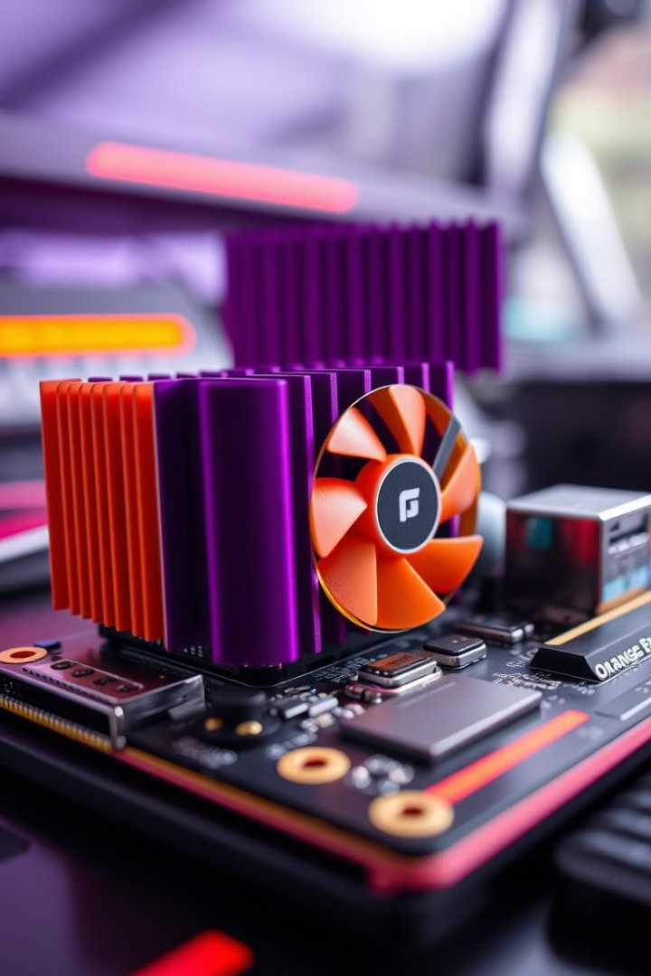
Overcoming Orange Pi 5 Overheating
Problem: Overheating during AI model inference
Solution: Installed heatsink and USB fan for thermal control
Critical step for stable embedded AI performance under load

Slide 8
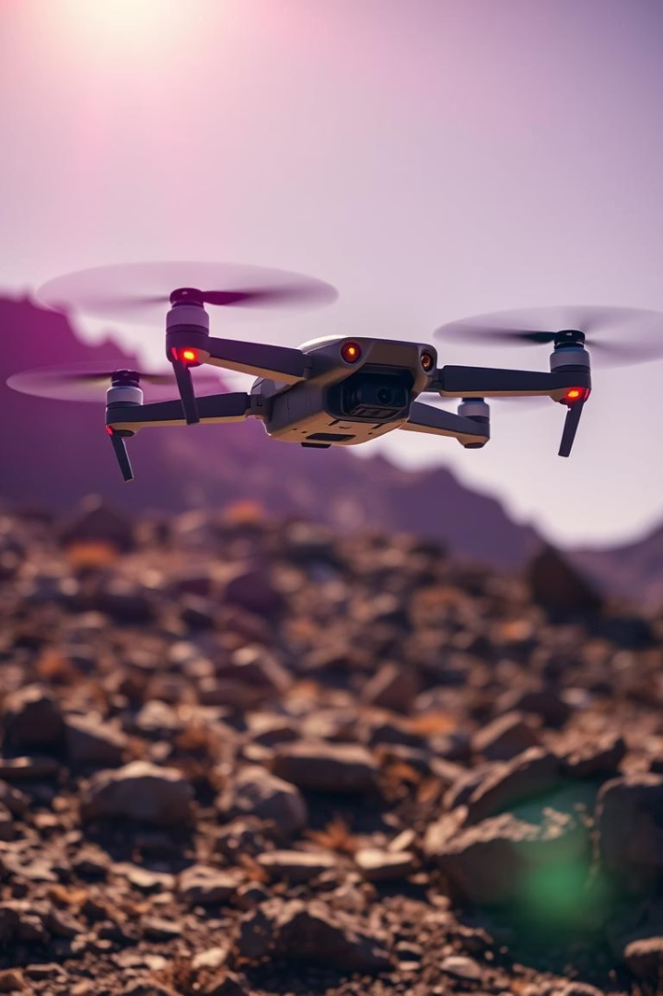
Intelligent Drone Feature Overview
Visual Tracking
Drone autonomously tracks objects in real-time
Obstacle Avoidance
Detects and navigates around obstacles safely
Gesture Recognition
Interprets user hand motions for control
Voice Commands
Feature pending implementation and testing

Slide 9
Future Enhancements for Drone AI
Voice Control
1
Implement ReSpeaker Mic Array and speech recognition
Advanced Gesture Recognition
2
Apply deep learning for higher accuracy
SLAM Integration
3
Add simultaneous localization and mapping

Slide 10
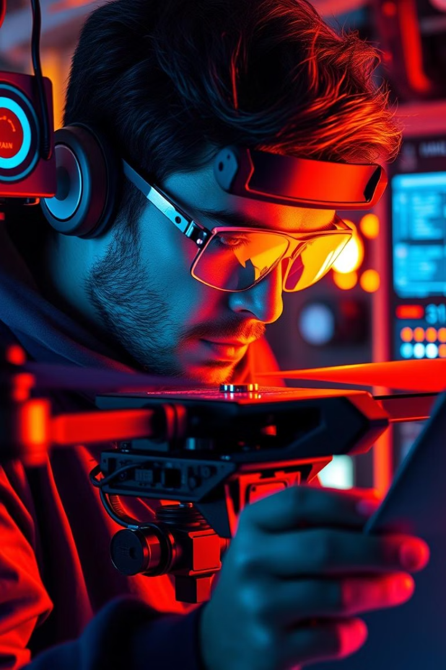
Key Learnings from Project
Real-time AI on Embedded Systems
Sensor and Protocol Integration
Hands-on experience combining AI and hardware
Multiple sensors and communications merged effectively
Debugging & Team Collaboration
Strengthened skills in co-development and testing

